Slide 1
Organization of the Autonomic Nervous System-II
By Dr.Sajid Hussain
Objectives
Discuss autonomic receptor
Know functional organization of ANS
Describe receptors in correlations with their neurotransmitter and function

Slide 2
Autonomic receptors
Adrenergic receptors | Cholinergic reeptors
Alfa (α) & beta(β) adrenoceptors | Muscarinic(M) & Nicotinic (N) receptors

Slide 3
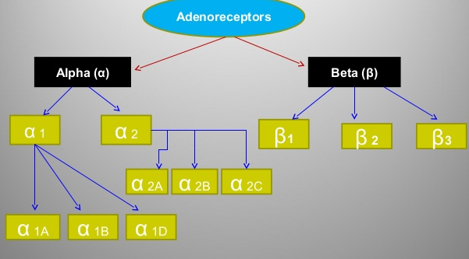
Adrenergic receptors

Slide 4
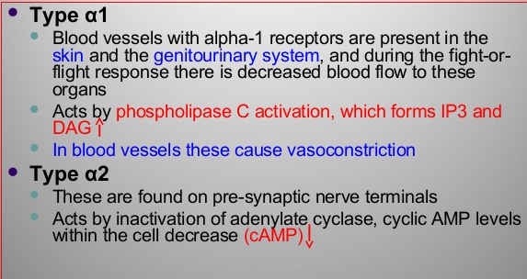
α –adrenergic receptors
IP3- inositol triphosphate, DAG- Diacytl glycerol, cAMP- Cyclic Adenosine Monophsphate

Slide 5
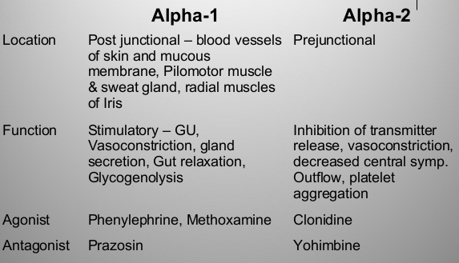
Differences between α1 and α2

Slide 6
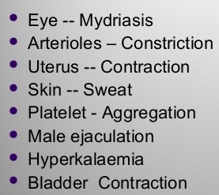
α1 and α2
α2 is an autoreceptor and inhibits NA release

Slide 7
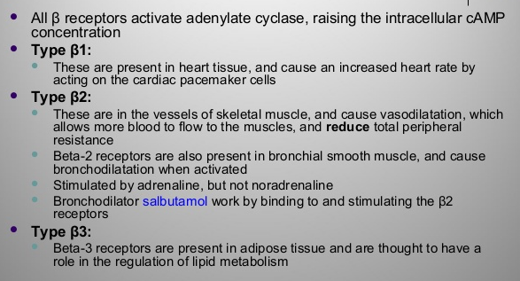
β-receptors

Slide 8
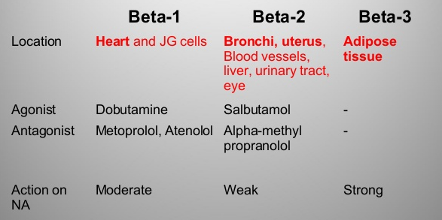
β-receptor

Slide 9
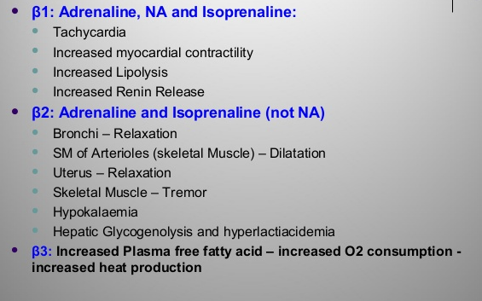
Effects of β-receptor

Slide 10
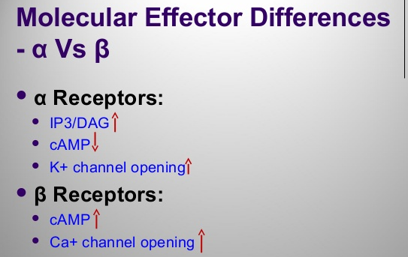

Slide 11
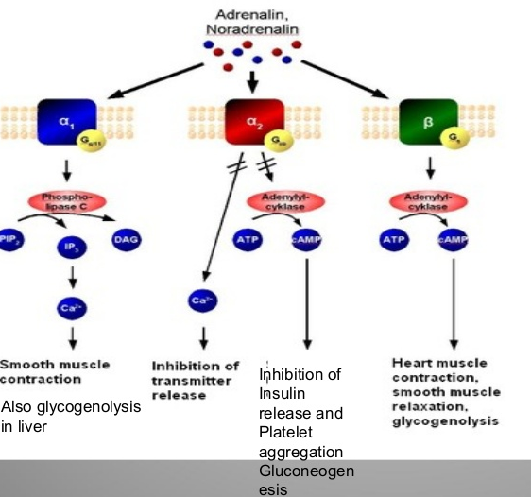

Slide 12
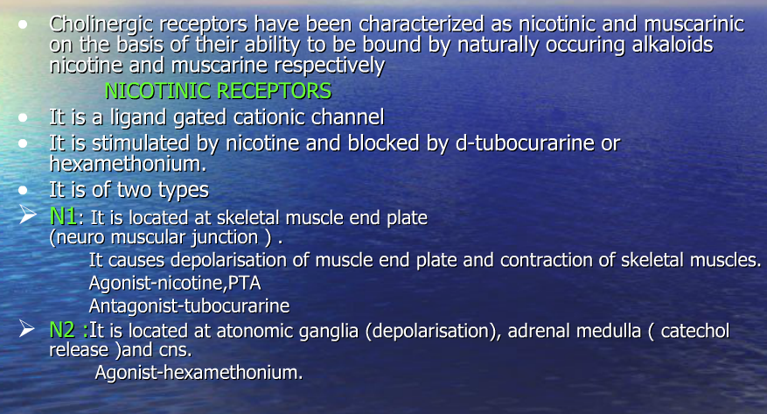
Cholinergic / parasympathetic receptors

Slide 13
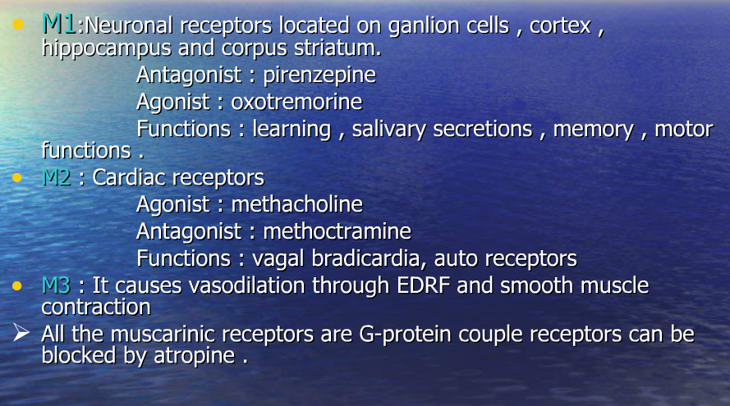
Muscarinic receptor

Slide 14
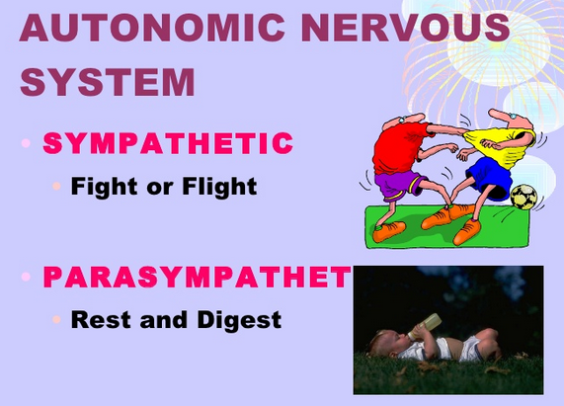

Slide 15
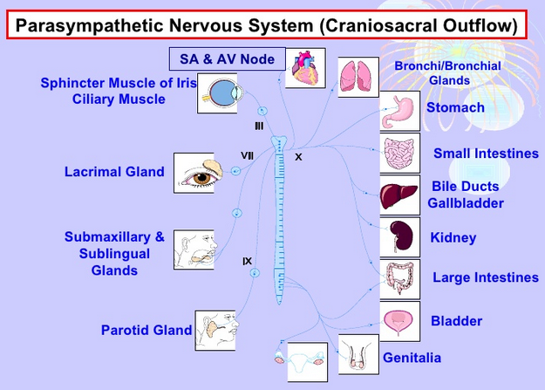
Funtional organization of parasympathetic system
↓ HR, ↓ conductivity
Bronchoconstriction, ↑ secretion
Miosis, ↓IOP,
contraction of ciliary m
↑ Hcl secretion
↑secretion, peristalsis
↑ lacrimation
↑ contraction
↑ secretion & salivation
Sphincter contraction
↑ secretion,
salivation
Erection in males

Slide 16
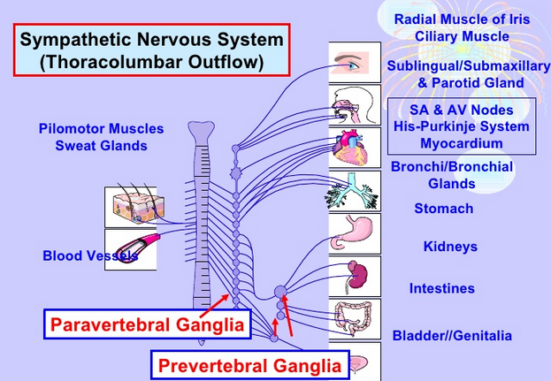
Functional organization of sympathetic system
Mydriasis
Thick secretions
↑HR and conduction
↑ sweating (Ach)
bronchodilation
relaxation
Release of renin
relaxation
Ejaculation in males

Slide 17
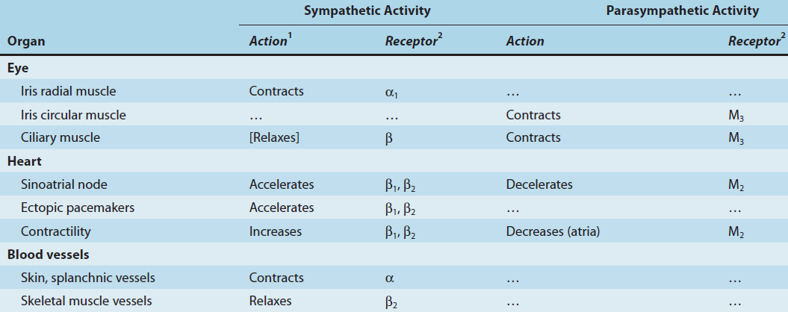
Receptor correlation
Neurotransmitter NA
Neurotransmitter Ach

Slide 18
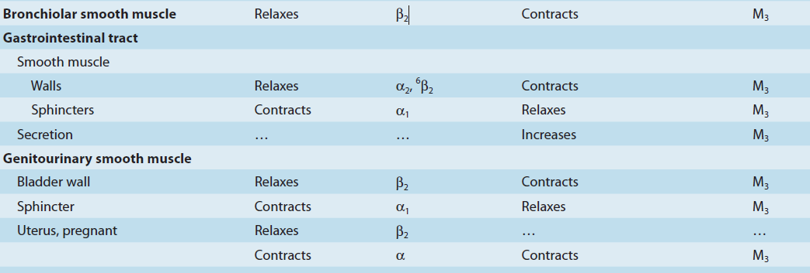
Receptor correlation Sympathetic Parasympathetic

Slide 19
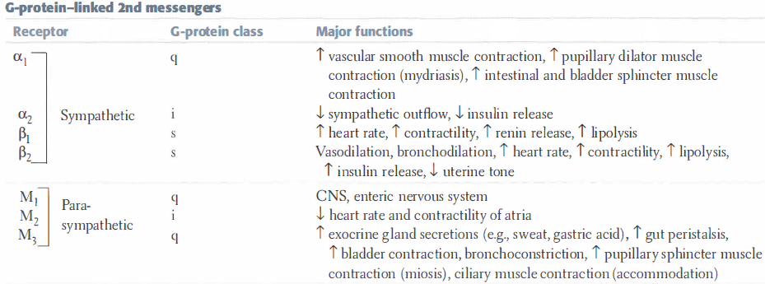
summary

Slide 20
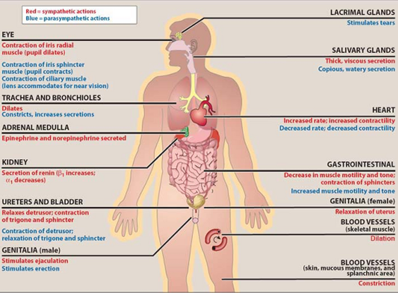
summary

Slide 21
References
Lippincott’s Illustrated review of pharmacology – 4th edition
Basic & clinical pharmacology, Bertram G katzung-12th edition
Goodman & Gilman’s –pharmacology
Internet resource

